Slide 1

Blazor in .net 8

Slide 2
Agenda
New Feature
Blazor Web Hosting
Render Mode
LifeCycle
PreRender
Publish
123

Slide 3
New Features
Feature | Detail | Hosting Support
 |  | Web | WebAssembly | Server(7.0)
Form | AntiforgeryToken | ✔️ | ✔️ | ✔️
 | SupplyParameterFromFormAttribute | ✔️ | ✔️ | ✔️
 | Enhanced form handling | ✔️ | ✔️ | ✔️
DataBinding | Two way binding: @bind:get/set | ✔️ | ✔️ | ✔️
Stream Rendering | StreamRenderingAttribute | ✔️(Server) | ❌ | ❌
Error Page | Default errorpage: /Pages/Error.razor | ✔️ | ❌ | ✔️
Route to named elements | Navigation.NavigateTo("/counter#targetElement"); | ✔️ | ✔️ | ✔️
Webcil packaging | Published with .wasm instead of .dll file | ✔️(WebAssembly) | ✔️ | ❌
Handle errors | Use ComponentBase.DispatchExceptionAsync | ✔️ | ✔️ | ✔️
 | Use IHostEnvironment | ✔️ | ❌ | ✔️
WebAssembly Runtime | Configure the .NET WebAssembly runtime | ✔️(WebAssembly) | ✔️ | ❌
Dialog | Support for dialog cancel and close events | ✔️ | ✔️ | ✔️

Slide 4
New Features
Feature | Detail | Hosting Support
 |  | Web | WebAssembly | Server(7.0)
Quick Grid | Blazor QuickGrid component from .net 7 | ✔️ | ✔️ | ✔️
Render outside asp .net core | Render Razor components outside of ASP.NET Core
Identity UI | generating a full Blazor-based Identity UI | ✔️ | ❌ | ❌

Slide 5
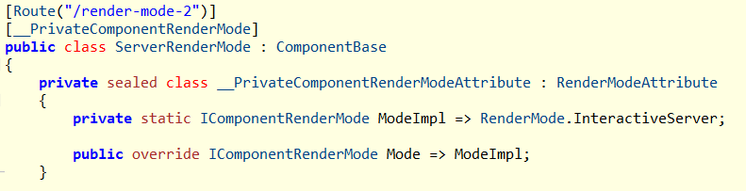
BlazorWeb Hosting
Render Mode
Component will generate a private __PrivateComponentRenderModeAttribute which distingulish the RenderMode:

Slide 6
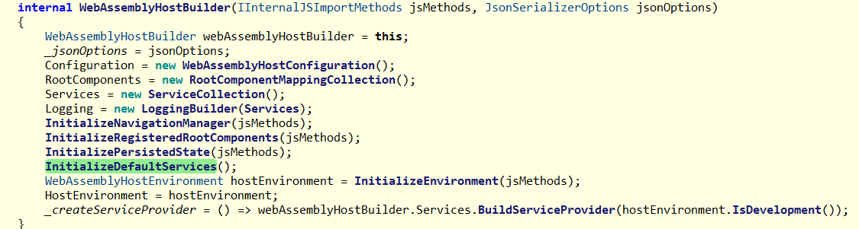
BlazorWeb Hosting
WebAssemblyHostBuilder.cs

Slide 7
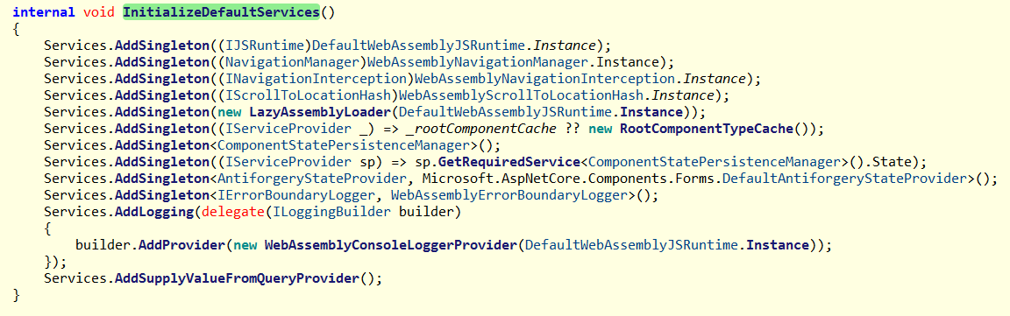
BlazorWeb Hosting

Slide 8
WebApplicationBuilder
Blazor.web hosting:
WebApplicationBuilder.Services.AddRazorComponents()

Slide 9
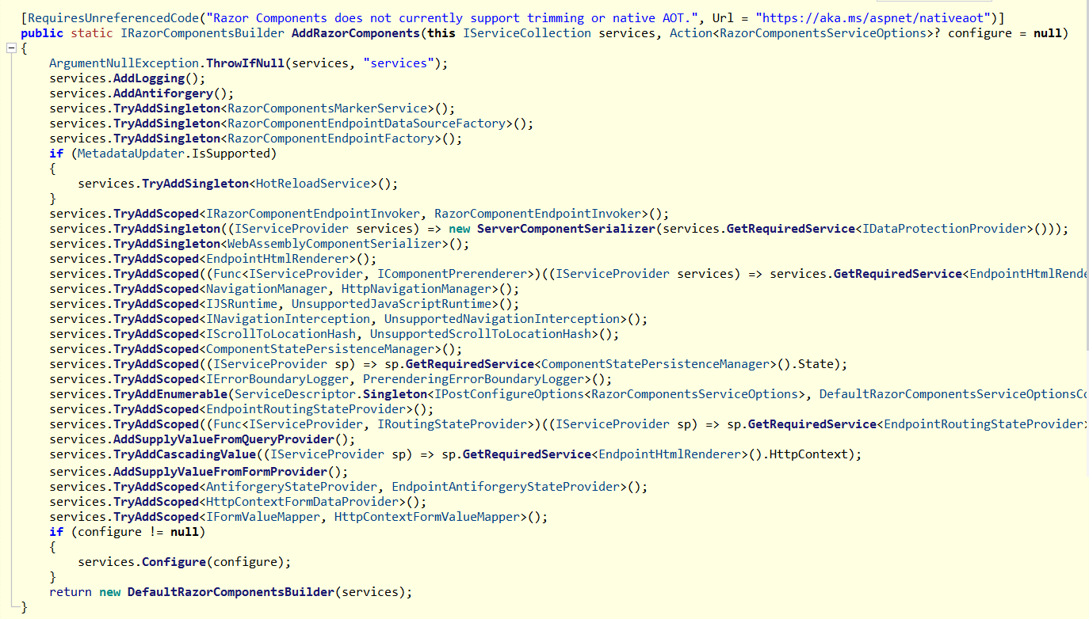

Slide 10
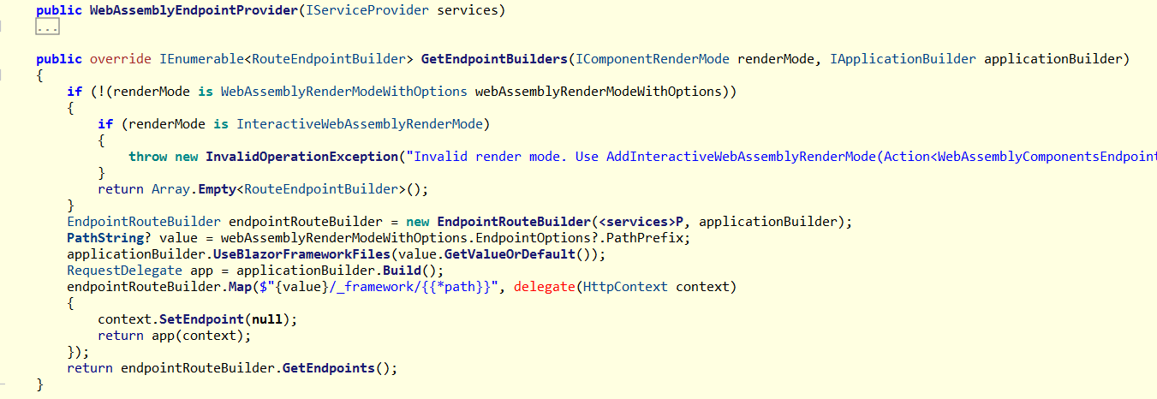
WebApplicationBuilder
AddInteractiveWebAssemblyComponents

Slide 11
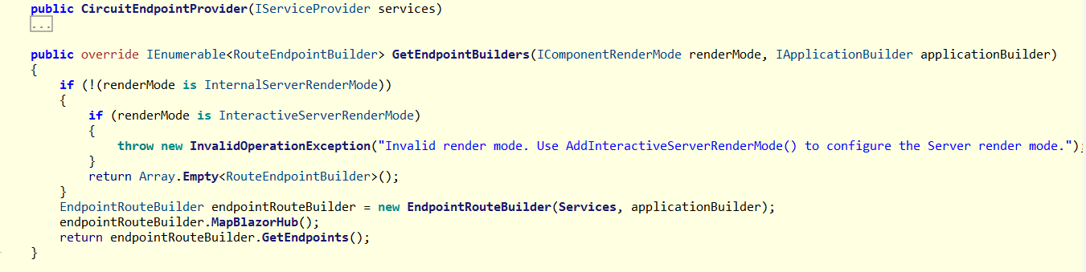
AddInteractiveServerComponents

Slide 12
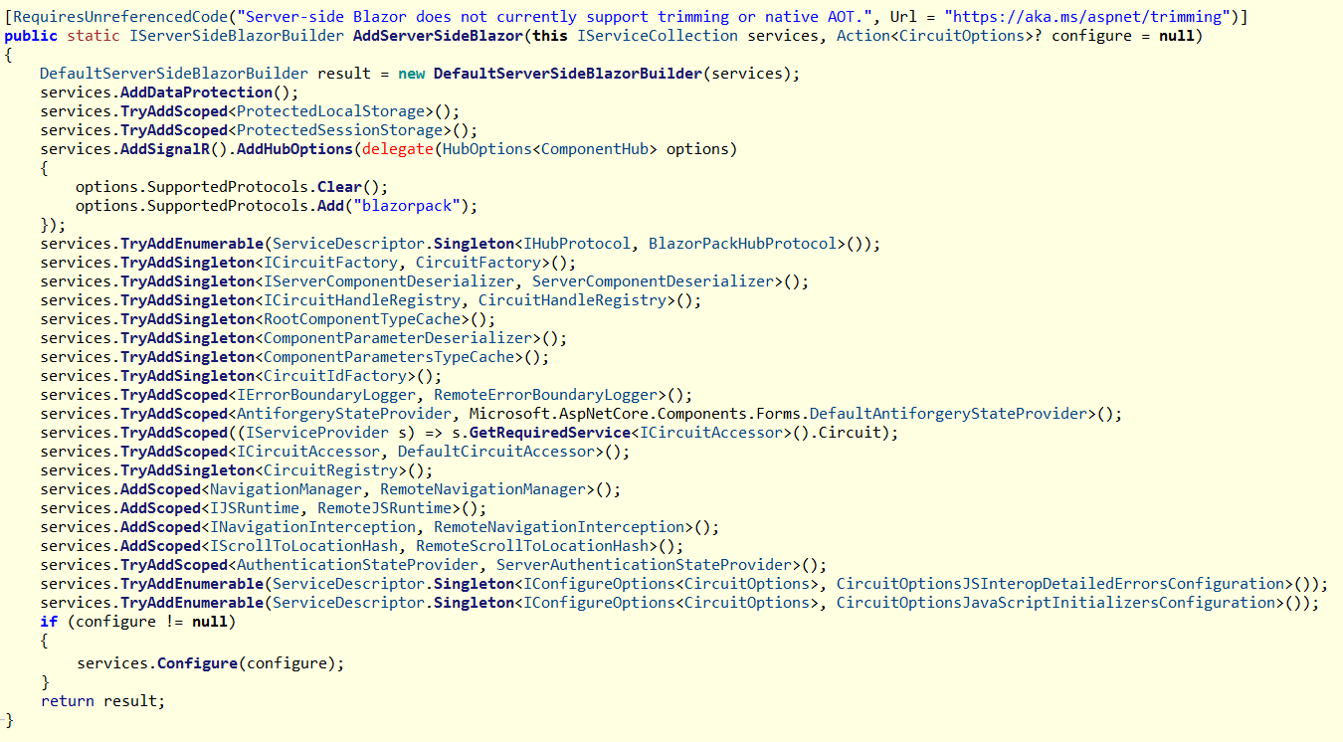

Slide 13
Life Cycle
ASP.NET Core Razor component lifecycle
Blazor Server/WebAssembly .net 6.0/8.0 | Blazor Web Server .net 8.0 | Blazor Web WebAssembly .net 8.0 | Blazor Web Static .net 8.0
SetParametersAsync - Begin OnInitialized OnInitializedAsync OnParametersSet OnParametersSetAsync SetParametersAsync - End OnAfterRender (First render: True) OnAfterRenderAsync (First render: True) | SetParametersAsync - Begin OnInitialized OnInitializedAsync OnParametersSet OnParametersSetAsync SetParametersAsync - End SetParametersAsync - Begin OnInitialized OnInitializedAsync OnParametersSet OnParametersSetAsync SetParametersAsync - End OnAfterRender (First render: True) OnAfterRenderAsync (First render: True) | SetParametersAsync - Begin OnInitialized OnInitializedAsync OnParametersSet OnParametersSetAsync OnAfterRender (First render: True) OnAfterRenderAsync (First render: True) SetParametersAsync - End | SetParametersAsync - Begin OnInitialized OnInitializedAsync OnParametersSet OnParametersSetAsync SetParametersAsync - End

Slide 14
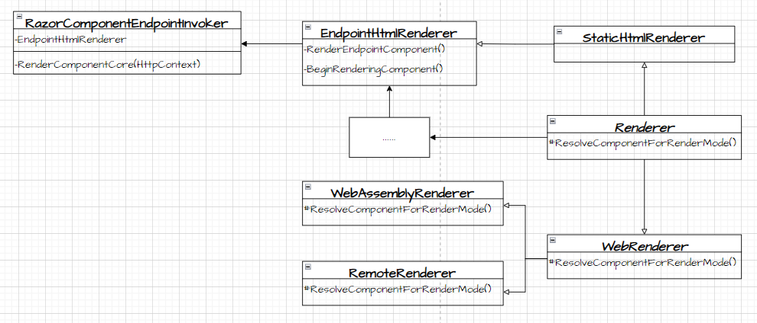
Render By different Mode
Render Componment:
RazorComponentEndpointInvoker.cs
RazorComponentEndpointInvoker.RenderComponentCore()
1. Initialize StreamingRendering Framing
2. Initialize Standard Component Services
3. Render Endpoint Component
3.1 InstantiateComponent
3.1.1 ResolveComponentForRenderMode
3.2 Waiting for quiesence(none stream Rendering) complete
4. write by HttpResponseStreamWriter

Slide 15
Render By different Mode
Render Componment:
RazorComponentEndpointInvoker.cs
RazorComponentEndpointInvoker.RenderComponentCore ->
EndpointHtmlRenderer.InitializeStandardComponentServicesAsync
EndpointHtmlRenderer.RenderEndpointComponent->
BeginRenderingComponent->
ComponentFactory.InstantiateComponent
WaitForResultReady() wait for quiescence of the non-streaming subtrees
EndpointHtmlRenderer.PrerenderPersistedStateAsync ->
return ComponentStateHtmlContent with different PrerenderComponentApplicationStore
Write by HttpResponseStreamWriter

Slide 16
Render By different Mode
Create Component:
ComponentFactory.cs
ComponentFactory.InstantiateComponent
Renderer.ResolveComponentForRenderMode -> override by EndpointHtmlRenderer/WebAssemblyRenderer : WebRenderer / RemoteRenderer : WebRenderer
->IComponentActivator.CreateInstance ->Implement by DefaultComponentActivator
->PrerenderPersistedStateAsync
RazorComponentEndpointInvoker.RenderComponentCore ->
EndpointHtmlRenderer.RenderEndpointComponent->
…-> ComponmentFactory.InstantiateComponent

Slide 17
